Slide 2
Culture Offer Launched Autumn 2017

Slide 3


Slide 4
Although public libraries in some countries have experienced a decrease in the number of loans over the past few years, they have intensified their role as central cultural and public spaces.
In many countries libraries are the most frequented cultural institutions, sometimes having more visits that national football leagues
Committee on Culture and Education, European Parliament (2016)

Slide 5
UNESCO Public Library Manifesto 1994
UNESCO articulates a belief in public libraries a living force for education, culture and information and an essential agent for fostering peace and spiritual welfare through the minds of men and women

Slide 6
Speaking volumes the impact of public libraries on wellbeing) Carnegie UK Trust
Libraries are spaces in which people can be creative, where groups can meet to pursue a shared interest in arts and crafts, or where they can explore new ways of communicating using new technology, music or other art forms. They can be venues for concerts, exhibitions or performances, attracting new audiences. They support self expression in places where there are no other options. Their local history collections are at the heart of communities defining themselves.

Slide 7
Culture Offer: Survey of SCL members 2017
94% of library services said they provide the space for people to experience cultural activities in their libraries
81% of libraries services said they had a partnership in place with the arts, museums and galleries sector
40% have cultural education partnerships and digital partnerships in place
26% reported economic partnerships with creative businesses

Slide 8
The Culture Offer
Core
Stretch
To offer quality and diverse cultural experiences in public libraries
To collaborate with arts and cultural organisations to reach local communities and people who do not usually participate in the arts
To ensure children, young people and their families are able to take part in a wide range of cultural experiences
People see libraries as local creative hubs where exploration, experimentation, creative making are encouraged
A wider range of cultural experiences are offered
Cultural leadership
Libraries partner with the professional and emerging arts sector

Slide 9
How it will work
Service–wide – not expected that every library will deliver it all
New regional and national partnerships and opportunities to programme events, including touring– economies of scale with local flexibility
Targeted projects for groups who do not engage with arts and culture
Cultural volunteering opportunities in libraries

Slide 10
Values underpinning the offer
Celebration of community/ building community pride
Co-creation with communities
Experimentation, proto-typing, risk taking
Challenge thinking
Exploration of identity
Celebration of diversity
Quality

Slide 11
Culture offer plans for the next 4 years
Look at digital arts projects–supporting STEM
Support library staff skills in fund raising – not just bid writing
Focus on E: learning and skills development, understanding language/quality
Looking for ways to measure impact and tell the story – Marketing
Developing partnerships with major cultural organisations
Work on Specific annual campaigns focusing on major anniversaries
Engagement with NPOS and Local Cultural Education Partnerships
Co-create customer facing version of the offer with children and young people

Slide 12
Opportunities
Arts Council 25 Creative Talent Plan
The Durham Commission on Creativity and Education.
Libraries as community arts leaders, LCEPS – future success of libraries

Slide 13
Libraries contributing to local place making/ economy. The Warwick Commission in 2015 identified the following issues for art and culture: localism diversity participation gap the need to focus outside of London all of which libraries can support
Opportunities

Slide 14
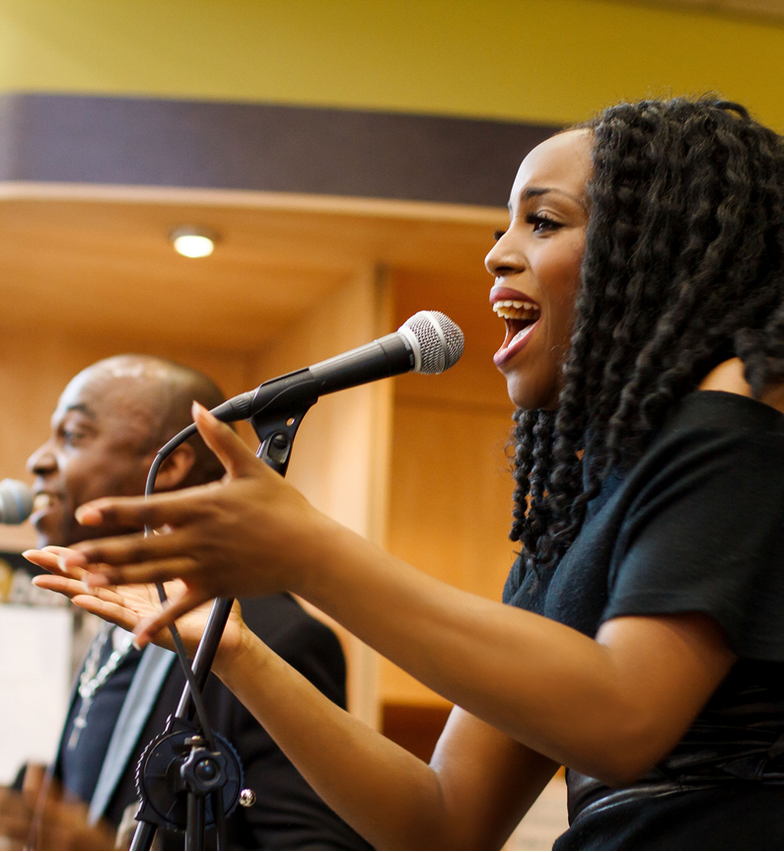
Why arts and culture are important
They have the potential to
make connections
Develop voice and agency
Rehearse ideas
Communicate meaning
Encourage reflection
Engage emotions and empathy
Encourage imagination
Challenge and disrupt
Encourage interaction
Encourage creative thinking
Influence mood
Arts and Kindness 2012, People United Publishing

Slide 15
All Party Parliamentary Group on Arts, Health and Wellbeing June 2017
Children and Young People Arts engagement in schools can improve social and emotional wellbeing in pupils.
Community-based arts activities help children and young people explore identities, build confidence and increase coping strategies.
Creative activity undertaken outside of work can hasten recovery from work strain and enhance work-related performance.
There is evidence that arts engagement should be thoughts of as an integral part of healthy ageing.

Slide 16
Libraries, deprivation and arts and culture
Those who take part in arts and culture tend to be the most well-off with one notable exception – library use. Library use is the only form of arts and cultural participation in England where levels of socio-economic deprivation make little significant difference, for all other types of arts and cultural participation ,those living in the most deprived areas are least likely to participate.
Added to this, we know that when children from low-income families do take part in arts activities, especially at school, they are three times more likely to go and to get a degree. In other words for the least well off, culture can be a route to opportunity and libraries are a route to culture
Rewriting the story: the contribution of public libraries to place-shaping- a report by Shared Intelligence for Arts Council England July 2017

Slide 17
Creative education is central to our nation's future success
“Everybody wants their kids to be numerate and literate but if you can't use your imagination and can't solve problems you are sadly lacking in key skills for life and work, never mind the joy of using your creativity for a better life.”
Sir John Sorrell outgoing chair of the Creative Industries Federation May 2017

Slide 18
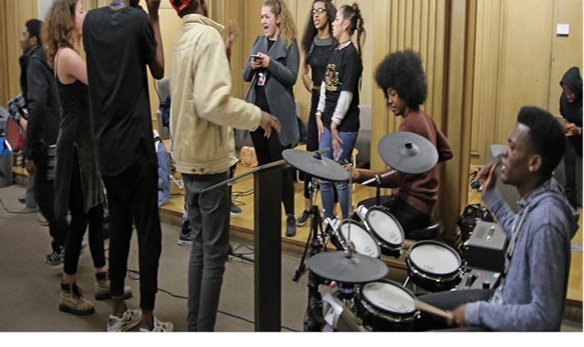
Creative industries
£84.7 billion per year and growing

Slide 19
Film
librariesconnected.org.uk/
universal-offers/culture
#LibsCulture

